Slide 1
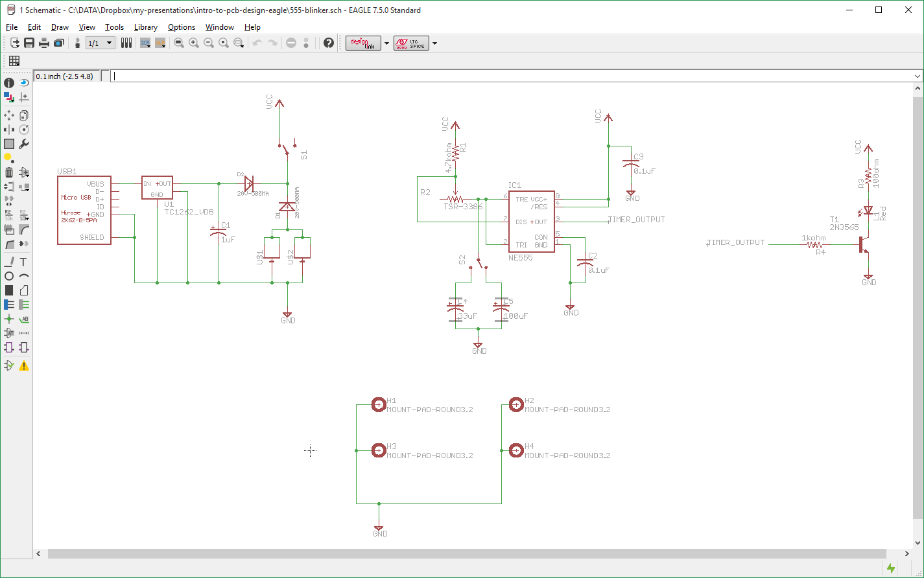
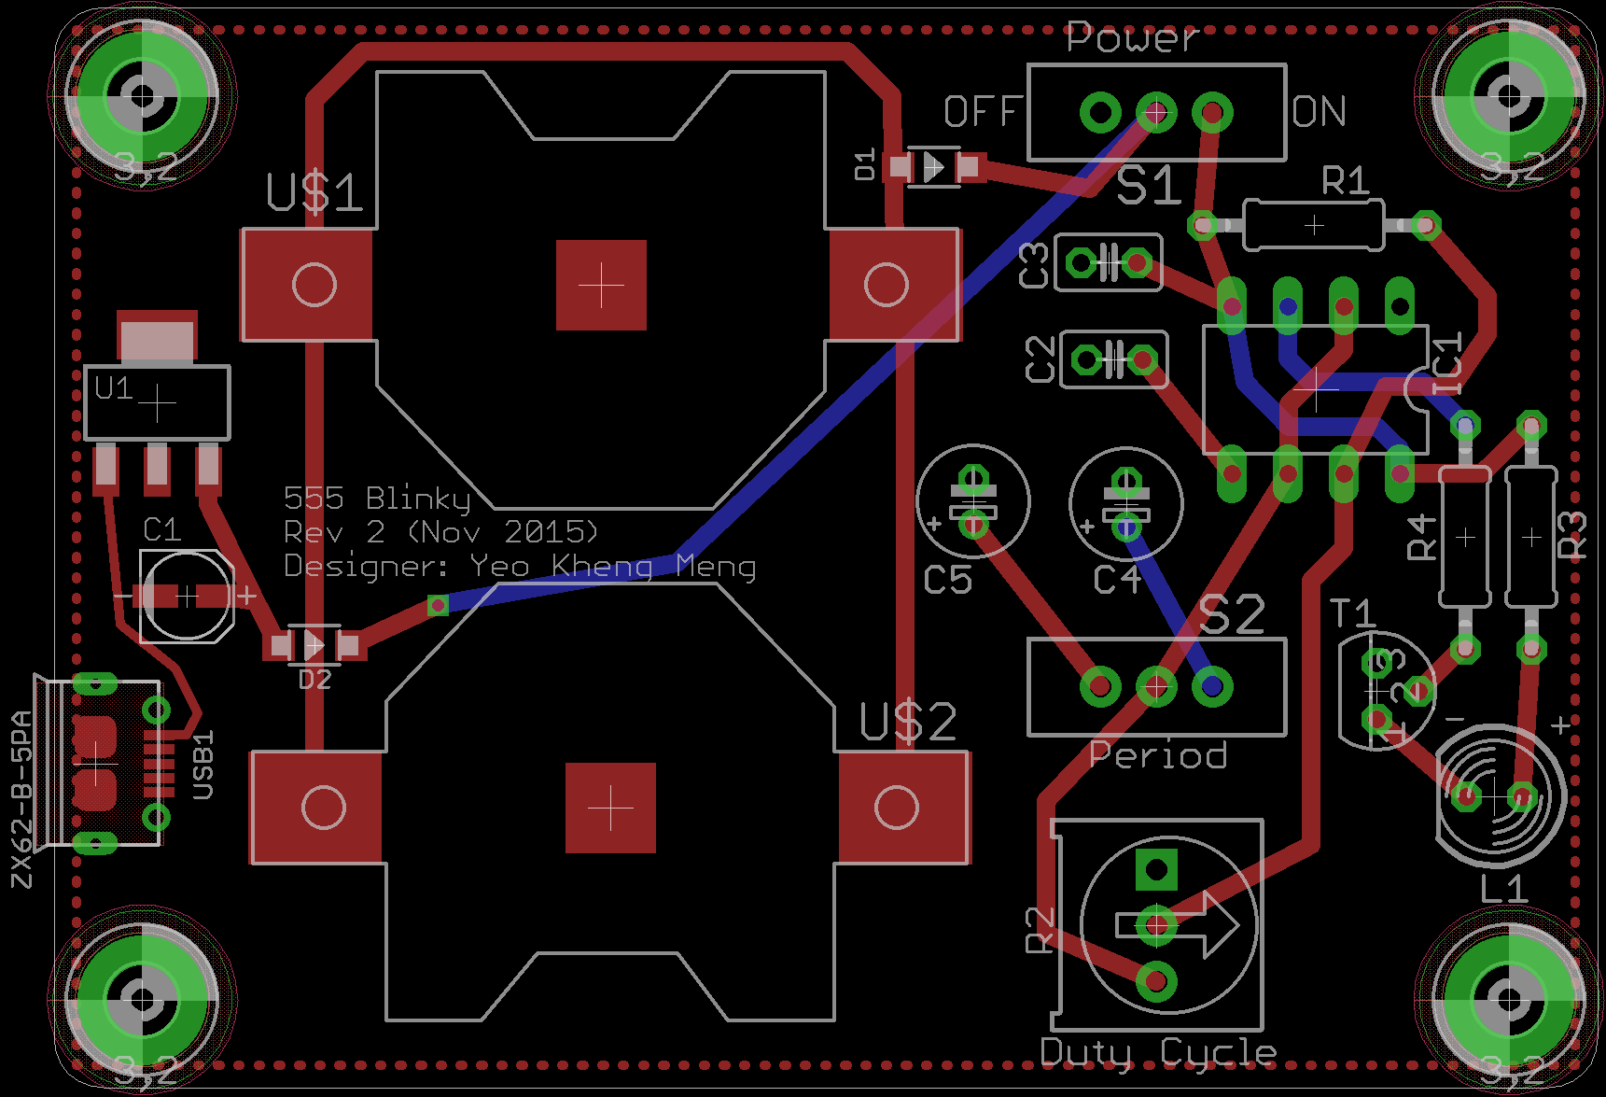
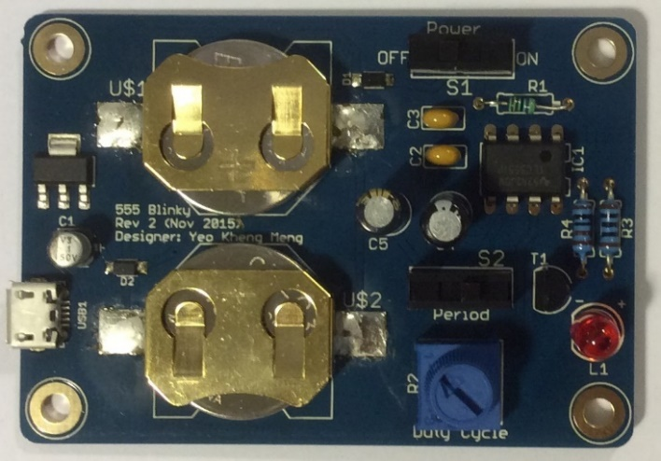
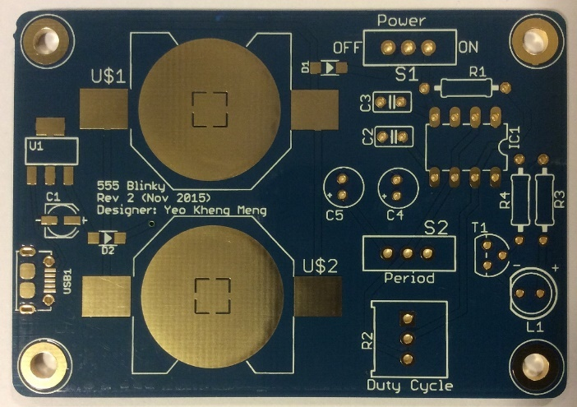
Introduction to PCB Design (with Eagle)
OMG Assistants (7 Dec 2015)
OMG Public (21-22 Jan 2016)
By: Yeo Kheng Meng (yeokm1@gmail.com)
https://github.com/yeokm1/intro-to-pcb-design-eagle

Slide 2

About Me
Graduated from NUS Computer Science in 2015
Engineer at med-tech startup Algo Access

Slide 3
What is a PCB?
Printed Circuit Board
A printed circuit board (PCB) mechanically supports and electrically connects electronic components using conductive tracks, pads and other features etched from copper sheets laminated onto a non-conductive substrate.
Wikipedia
Layman definition:
A board that lets you attach components to make a circuit.

Slide 4
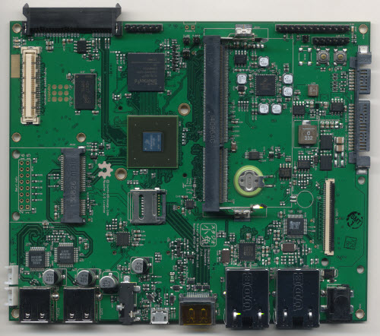
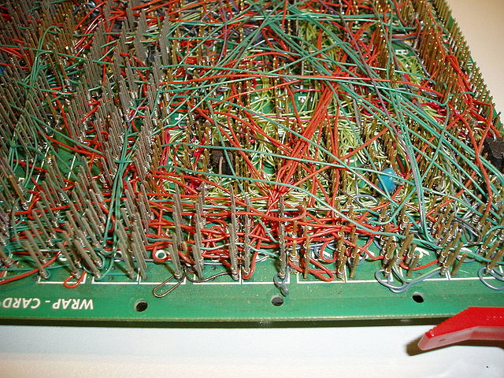
Before the PCB
vs
Point to point wire wrapping
Modern PCB of Novena laptop
Source: https://cdn.sparkfun.com/r/700-700/assets/1/3/b/5/8/50cba0dcce395fb716000000.jpg
Source: http://bunniefoo.com/novena/pvt2_release/novena_pvt2_top_sm.jpg

Slide 5
Motivation for makers?
Space and weight constraints
Making multiple copies of a design
Reduce mistakes in manual wiring/soldering
Aesthetics
Durability

Slide 6
Objective of lesson
Fundamental knowledge to
Understand PCB concepts
Design a PCB
Send for manufacturing
Properly share your design with others
Efficient SMD assembling techniques

Slide 7
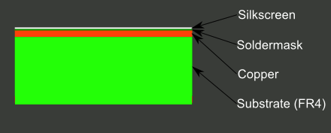
Structure of a 1-layer PCB board
Modified from: https://cdn.sparkfun.com/assets/3/f/c/b/c/50d0c95bce395fd321000000.png
Usually 1.6mm thick – applies to 2-4 layers too
Silkscreen (usually white):
Ink text. Usually used to mark out components
Soldermask (usually green):
Prevent solder (paste) from flowing out of designated areas forming solder bridges
Made of lacquer polymer that is “solderphobic”
Protects copper layer from oxidation
Copper:
Contains the traces (wires) between components
Also contains a ground/power plane (to be explained later)
Substrate
Gives the PCB mechanical strength and rigidity
Usually made of FR-4, composite of fibreglass and epoxy resin

Slide 8
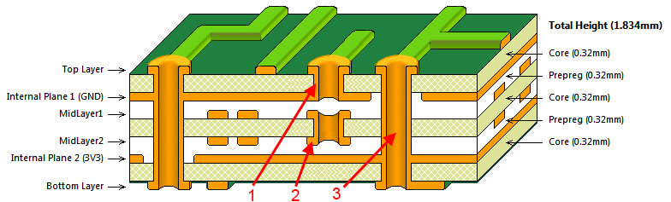
Structure of a (≥2) multi-layer PCB board
Source: http://techdocs.altium.com/display/ADRR/PCB_Obj-Via((Via))_AD
2-layer board = 2 copper layers, 4-layer board = 4 copper layers, etc
2-layer boards good enough for most use-cases
Silkscreen and soldermask on top and bottom only
Vias
Hole in PCB that electrically connects points between copper layers
1. Blind (only for >2 layer board)
2. Buried (only for >2 layer board)
3. Through-hole

Slide 9


Electronic Design Automation (EDA) Software
Software that helps you design PCBs
Eagle
Commonly used by makers + Adafruit + Sparkfun
Extensive library support
User-interface so-so
“Lite” version supports max 2 copper layers, 100 x 80 mm board size
Not the best for high-speed designs
Multi-platform
Saved as XML (ASCII) files, great for version-control
Altium Designer
Industry standard
De-facto option for high-speed designs and complex PCBs
Circuit simulation
User-interface is unrivaled IMO
File saved as binary format, terrible for version-control
Windows-only
Expensive: US$10K/license
KiCad
Recently becoming more popular
Free & open-source with no limitations
Libraries not as common
Saves in ASCII files, great for version-control
Multi-platform

Slide 10
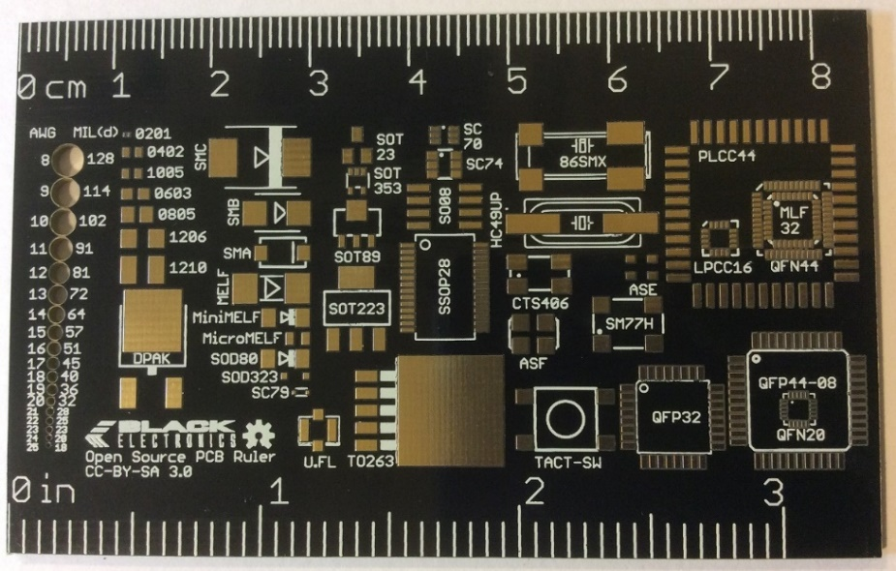
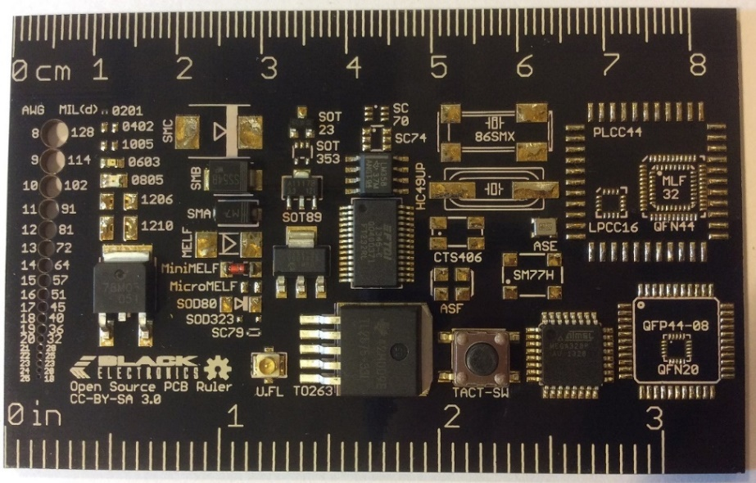
Component packages
2D physical dimension of a component
Determines number of solder pads/sizes
Common surface-mount packages
2-pin passives (don’t rely on external power)
0603 (0.063 inch × 0.031 inch), 0805 (0.079 in × 0.049 in), 1206 (0.126 inch × 0.063 inch), …
SOD-123 (Small outline diode)
MELF (Metal electrode leadless face) cylindrical SMT component
≥ 3 pins Active Components (rely on external power)
SOT23, SOT-223-4 (Small Outline Transistor: 2.2mm pitch, 3 pins front, 4 pins total), …
Integrated circuits (ICs), usually dual-inline or square
SOIC-16 (Small Outline Integrated Circuit 16 pins)
SSOP-28 (Shrink small outline package 28 pins)
TQFP-32 (Thin Quad Flat Package 32 pins)
QFN-48 (Quad Flat No leads 48 pins)
Others
Ports like USB, audio,
Board to board connectors like DF40C(2.0)-70DS-0.4V
Pin headers
uFL antenna connector
https://github.com/yeokm1/open-source-pcb-ruler https://github.com/hemalchevli/Open-Source-PCB-Ruler

Slide 11
PCB Design/Manufacturing Workflow
1. Establish project requirements
2. Acquire parts and prototype
3. Design your PCB schematic
4. Run electrical rule check (ERC).
5. Design board: place parts & wiring
6. Setup/run design rule check (DRC)
7. Do 3D rendering
8. Use CAM file to generate Gerbers
9. Zip up relevant Gerber files
10. Set PCB fabrication settings
11. Write out bill of materials (BOM)
12. PCB Assembly

Slide 12
1. Establish project requirements
1. Establish project requirements
Circuit that blinks an LED
Customisable blink period
Customisable blink cycle
Run on CR2032 coin cells
Can run off USB power
Power switch
2. Acquire parts and prototype
3. Design your PCB schematic
4. Run electrical rule check (ERC).
5. Design board: place parts & wiring
6. Setup/run design rule check (DRC)
7. Do 3D rendering
8. Use CAM file to generate Gerbers
9. Zip up relevant Gerber files
10. Set PCB fabrication settings
11. Write out bill of materials (BOM)
12. PCB Assembly

Slide 13
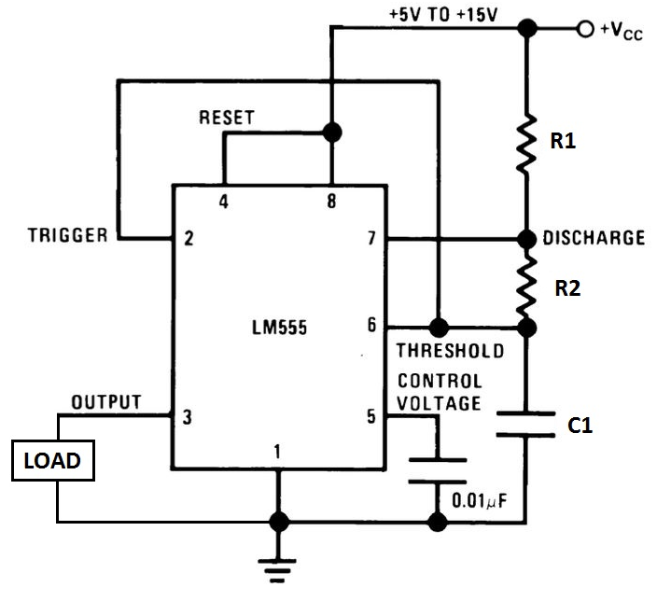
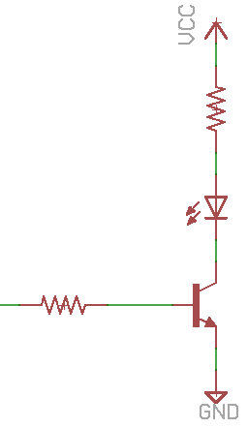
2. Acquire parts and prototype
Consult data sheets to understand part selection choices
Logic Components
Texas Instruments TLC555 timer
Switch (C1 selection)
C1: 33uF/100uF capacitor
R1: 4.7kohm resistor
R2: 10k potentiometer
2x 0.1uF decouple capacitors
Required according to TLC555 data sheet
Output components
5mm 20mA Red LED
100ohm current limiting resistor for LED
ON Semiconductor P2N2222A NPN Transistor
1k ohm base resistor
Power components
2x CR2032 battery holders
Micro-USB female connector
3.3V low-dropout TC1262 regulator
Diodes for battery protection
1uF output decouple capacitor
Required according to TC1262 datasheet
Switch to ON/OFF circuit
1. Establish project requirements
2. Acquire parts and prototype
3. Design your PCB schematic
4. Run electrical rule check (ERC).
5. Design board: place parts & wiring
6. Setup/run design rule check (DRC)
TLC555 cannot source high currents so we use a transistor to control the LED.
7. Do 3D rendering
8. Use CAM file to generate Gerbers
9. Zip up relevant Gerber files
10. Set PCB fabrication settings
11. Write out bill of materials (BOM)
12. PCB Assembly
*Quantity of 1 unless otherwise stated
Reference: http://www.circuitbasics.com/555-timer-basics-astable-mode/

Slide 14
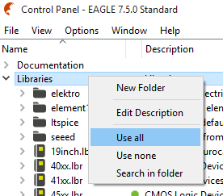
3a. Design your PCB Schematic
Schematic defines connections between components
Open Eagle and add external libraries
Import libraries.
Locate the libraries folder I have provided
Drag-and-drop the *.lbr files one by one into Eagle Control Panel Libraries folder
Right-Click on Libraries Folder -> Use all
1. Establish project requirements
2. Acquire parts and prototype
3. Design your PCB schematic
4. Run electrical rule check (ERC).
5. Design board: place parts & wiring
6. Setup/run design rule check (DRC)
7. Do 3D rendering
8. Use CAM file to generate Gerbers
9. Zip up relevant Gerber files
10. Set PCB fabrication settings
11. Write out bill of materials (BOM)
12. PCB Assembly

Slide 15
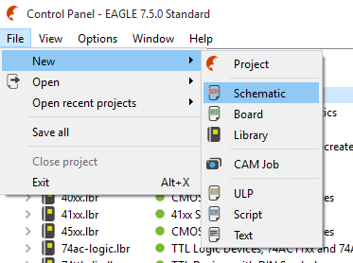
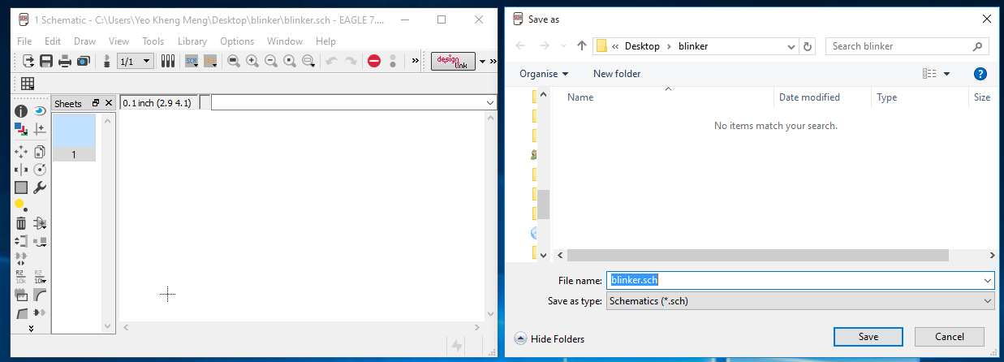
3b. Design your PCB Schematic
Create and save schematic file (part and connection layout)
Create a folder on desktop “blinker”
Create new schematic *.sch: File -> New -> Schematic
Save schematic
1. Establish project requirements
2. Acquire parts and prototype
3. Design your PCB schematic
4. Run electrical rule check (ERC).
5. Design board: place parts & wiring
6. Setup/run design rule check (DRC)
7. Do 3D rendering
8. Use CAM file to generate Gerbers
9. Zip up relevant Gerber files
10. Set PCB fabrication settings
11. Write out bill of materials (BOM)
12. PCB Assembly

Slide 16
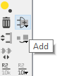
3c. Design your PCB Schematic
Add all Power components first
Micro-USB female connector
Seeed-OPL-Connector -> MICRO-USB-SMD(ZX62-B-5PA)
Or search 320010005 obtained via Seeedstudio OPL website
http://www.seeedstudio.com/depot/OPLopen-parts-library-catalog-c-136_138/
3.3V LDO
bt_regulator -> TC1262 -> SOT-223-3
1uF decoupling resistor
rcl- > CPOL-US -> CPOL-USUD-4X5,8
2x Diodes
Seeed-OPL-Diode -> SMD-DIODE-SCHOTTKY-20V-500MA(SOD-123)
Or search 304020028
2x CR2032 battery holders
cr2032-large-side -> CR2032SMT
Through-hole switch
Sparkfun-Electromechanical -> SWITCH_SPDT -> SWITCH-SPDTPTH
VCC and GND wiring net
Just search for them…
There are 2 functionally identical supply1 and supply2 options for VCC and GND, just pick any one you prefer.
1. Establish project requirements
2. Acquire parts and prototype
3. Design your PCB schematic
4. Run electrical rule check (ERC).
5. Design board: place parts & wiring
6. Setup/run design rule check (DRC)
7. Do 3D rendering
8. Use CAM file to generate Gerbers
9. Zip up relevant Gerber files
10. Set PCB fabrication settings
11. Write out bill of materials (BOM)
12. PCB Assembly

Slide 17
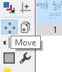
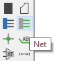
3d. Design your PCB Schematic
Maneuvering and layout
Zoom with scroll-wheel
Click-drag middle mouse button to move sheet
Rotate components
Choose Move command
Click component “+” sign then right-click
Define component value if needed
Right-click component -> Value
Delete object with trash icon
Wiring
Use “Net” command
Link components together
Hover mouse just overlapping the contacts
Press “Alt” increased precision key if wire cannot overlap
Left-click to set and also to change direction
1. Establish project requirements
2. Acquire parts and prototype
3. Design your PCB schematic
4. Run electrical rule check (ERC).
5. Design board: place parts & wiring
6. Setup/run design rule check (DRC)
7. Do 3D rendering
8. Use CAM file to generate Gerbers
9. Zip up relevant Gerber files
10. Set PCB fabrication settings
11. Write out bill of materials (BOM)
12. PCB Assembly

Slide 18
3e. Design your PCB Schematic
Add and wire Logic Components
Ignore TIMER_OUTPUT
TLC555 timer (dual in-line package)
st-microelectronics -> NE555
Not exact component but good enough
4.7kohm axial resistor
resistor -> R-US_ -> R-US_0207/10
2mm diameter, 7mm length, 10mm lead length
10kohm potentiometer
Sparkfun-Electromechanical -> TRIMPOT -> TRIMPOT-PTH-KNOB
Through-hole switch
Sparkfun-Electromechanical -> SWITCH_SPDT -> SWITCH-SPDTPTH
33uF and 100uF aluminum electrolytic ”can” capacitors
resistor -> CPOL-US -> CPOL-USE2-5
2mm lead spacing, 5mm diameter, polarised
2x 0.1uF ceramic decoupling capacitors
resistor -> C-US -> C-US025-025X050
2.5mm x 5mm area
VCC and GND
Just search for them…
1. Establish project requirements
2. Acquire parts and prototype
3. Design your PCB schematic
4. Run electrical rule check (ERC).
5. Design board: place parts & wiring
6. Setup/run design rule check (DRC)
7. Do 3D rendering
8. Use CAM file to generate Gerbers
9. Zip up relevant Gerber files
10. Set PCB fabrication settings
11. Write out bill of materials (BOM)
12. PCB Assembly

Slide 19
3f. Design your PCB Schematic
Expected result of Logic circuitry
Ignore “TIMER_OUTPUT” for now
1. Establish project requirements
2. Acquire parts and prototype
3. Design your PCB schematic
4. Run electrical rule check (ERC).
5. Design board: place parts & wiring
6. Setup/run design rule check (DRC)
7. Do 3D rendering
8. Use CAM file to generate Gerbers
9. Zip up relevant Gerber files
10. Set PCB fabrication settings
11. Write out bill of materials (BOM)
12. PCB Assembly

Slide 20
3g. Design your PCB Schematic
Add and wire Output Components
Ignore “TIMER_OUTPUT” for now
100ohm and 1kohm axial resistor
resistor -> R-US_ -> R-US_0207/10
2mm diameter, 7mm length, 10mm lead length
5mm Red LED
led -> LED -> LED5MM
ON Semiconductor P2N2222A NPN Transistor (TO92 package)
transistor -> 2N3565
Not exact component but good enough
VCC and GND
Just search for them…
1. Establish project requirements
2. Acquire parts and prototype
3. Design your PCB schematic
4. Run electrical rule check (ERC).
5. Design board: place parts & wiring
6. Setup/run design rule check (DRC)
7. Do 3D rendering
8. Use CAM file to generate Gerbers
9. Zip up relevant Gerber files
10. Set PCB fabrication settings
11. Write out bill of materials (BOM)
12. PCB Assembly

Slide 21
3h. Design your PCB Schematic
Wiring nets
Connects between two “regions”
VCC and GND are Eagle’s provided wiring nets
We now connect logic circuit to the output circuit via TIMER_OUTPUT
Steps
Extend a short dummy wire on one side
Right click, choose “Label”
Position “N$” label just beside wire
Rename to something easier like “TIMER_OUTPUT”
Repeat for the other end
1. Establish project requirements
2. Acquire parts and prototype
3. Design your PCB schematic
4. Run electrical rule check (ERC).
5. Design board: place parts & wiring
Our custom net
6. Setup/run design rule check (DRC)
7. Do 3D rendering
8. Use CAM file to generate Gerbers
9. Zip up relevant Gerber files
10. Set PCB fabrication settings
11. Write out bill of materials (BOM)
12. PCB Assembly

Slide 22
3i. Design your PCB Schematic
(Grounded) Mounting holes
Allows your PCB to be secured to external case
Grounded by screws.
Can also use normal ungrounded mounting holes
Appears in schematic as it is an electrical connection
Mounting hole
Grounded:
holes -> MOUNT-PAD-ROUND -> MOUNT-PAD-ROUND3.2
Ungrounded:
holes -> MOUNT-HOLE -> MOUNT-HOLE3.2
3.2mm hole fits M3 screws with slight allowance
1. Establish project requirements
2. Acquire parts and prototype
3. Design your PCB schematic
4. Run electrical rule check (ERC).
5. Design board: place parts & wiring
6. Setup/run design rule check (DRC)
7. Do 3D rendering
8. Use CAM file to generate Gerbers
9. Zip up relevant Gerber files
10. Set PCB fabrication settings
11. Write out bill of materials (BOM)
12. PCB Assembly

Slide 23
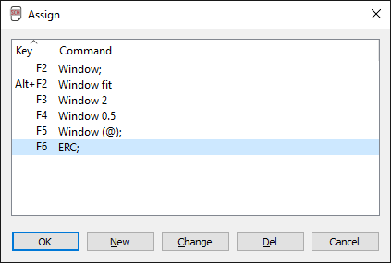
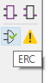
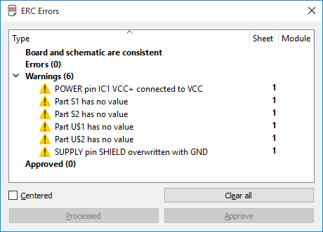
4. Run electrical check (ERC)
Tests if your wiring has been done properly
Not foolproof but usually good enough to detect weird or missing connections
Run ERC regularly, assign to shortcut key. Options -> Assign
Correct ALL errors
Inspect all warnings
Correct if needed
Ignore if you are sure
I discourage approving
1. Establish project requirements
2. Acquire parts and prototype
3. Design your PCB schematic
4. Run electrical rule check (ERC).
5. Design board: place parts & wiring
6. Setup/run design rule check (DRC)
7. Do 3D rendering
8. Use CAM file to generate Gerbers
9. Zip up relevant Gerber files
10. Set PCB fabrication settings
11. Write out bill of materials (BOM)
12. PCB Assembly

Slide 24
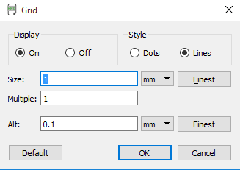
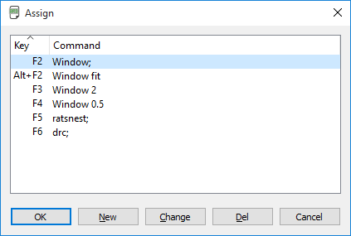
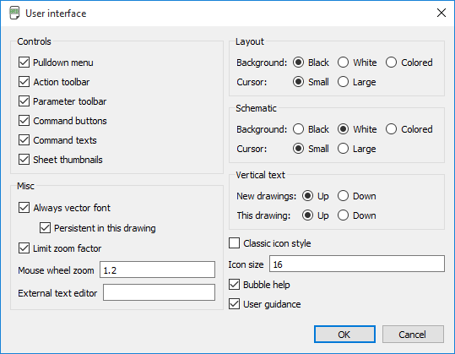
5a. Design board: place parts & wiring
Create and save board file (board layout)
File -> Switch to board
Initial board configuration
Adjust grid settings to mm as shown.
View -> Grid
Create keyboard shortcuts for commonly used functions.
Options -> Assign
Not case-sensitive
End with “;”
Enable Vector font
Options -> User Interface
Tick Always vector font
Tick Persistent
1. Establish project requirements
2. Acquire parts and prototype
3. Design your PCB schematic
4. Run electrical rule check (ERC).
5. Design board: place parts & wiring
6. Setup/run design rule check (DRC)
7. Do 3D rendering
8. Use CAM file to generate Gerbers
CAM Processor can only convert vector fonts into Gerbers properly.
See: http://www.cadsoftusa.com/training-service/faq/#c95
9. Zip up relevant Gerber files
10. Set PCB fabrication settings
11. Write out bill of materials (BOM)
12. PCB Assembly

Slide 25
6a. Setup/run design rule check (DRC)
Design rules provided by fabricator to check if your PCB adheres to requirements
Download PCB fabricator DRU, in this case Elecrow
http://www.elecrow.com/10pcs-2-layer-pcb-p-1175.html
http://www.elecrow.com/download/Elecrow_PCB_eagle_rule.zip
1. Establish project requirements
2. Acquire parts and prototype
3. Design your PCB schematic
4. Run electrical rule check (ERC).
5. Design board: place parts & wiring
6. Setup/run design rule check (DRC)
7. Do 3D rendering
8. Use CAM file to generate Gerbers
9. Zip up relevant Gerber files
10. Set PCB fabrication settings
11. Write out bill of materials (BOM)
12. PCB Assembly
*I use Elecrow as a learning example here but it does not mean I endorse this company in any way.

Slide 26
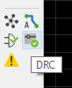
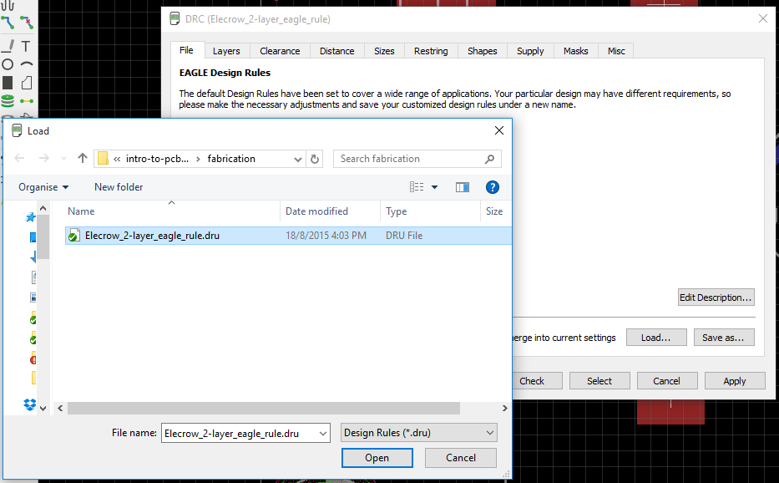
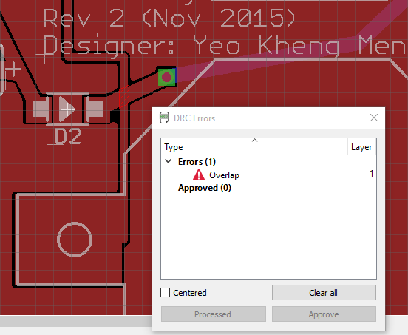
6b. Setup/run design rule check (DRC)
Load DRU file just once
Press “check” to check your board or use keyboard shortcut
Rectify all errors
1. Establish project requirements
2. Acquire parts and prototype
3. Design your PCB schematic
4. Run electrical rule check (ERC).
5. Design board: place parts & wiring
6. Setup/run design rule check (DRC)
7. Do 3D rendering
8. Use CAM file to generate Gerbers
9. Zip up relevant Gerber files
10. Set PCB fabrication settings
11. Write out bill of materials (BOM)
12. PCB Assembly

Slide 27
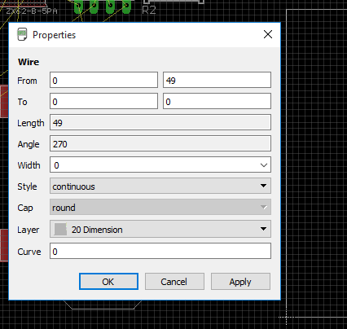
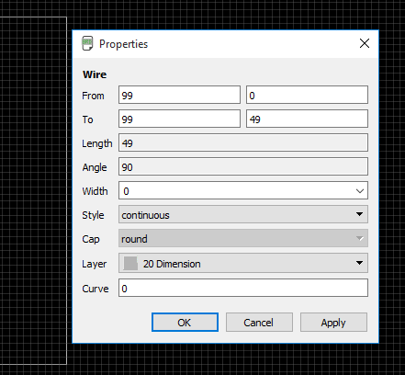
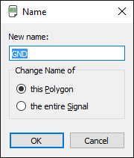
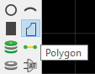
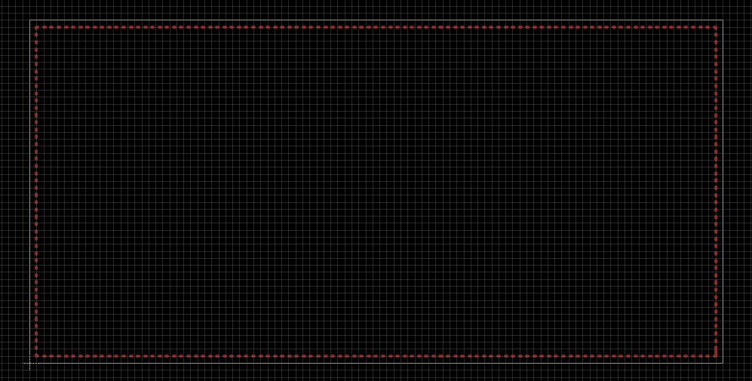
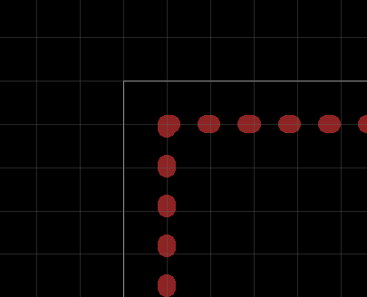
5b. Design board: place parts & wiring
General board steps
Adjust board size to your requirements eg: 99mm x 49mm (check fabricator price point)
Place ground/power plane on Top layer using polygon function. 1mm away from edges to ease future resizing. Set polygon name.
1. Establish project requirements
2. Acquire parts and prototype
3. Design your PCB schematic
4. Run electrical rule check (ERC).
5. Design board: place parts & wiring
6. Setup/run design rule check (DRC)
7. Do 3D rendering
8. Use CAM file to generate Gerbers
9. Zip up relevant Gerber files
10. Set PCB fabrication settings
11. Write out bill of materials (BOM)
12. PCB Assembly

Slide 28
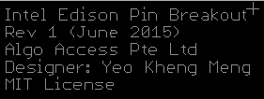
5c. Design board: place parts & wiring
General board steps
Component placement order
Place mounting holes
User-facing components, like USB connectors, switches and LEDs
Large components
Everything else
Wiring order (Trace width usually the size of the solder pads)
Wire high-speed connections, avoid using vias
Wire power connections with wider traces
Wire everything else
Execute DRC check and rectify if needed
Silkscreen placement order (don’t overlap with any holes/vias/parts)
Smash component & adjust part designators if required to minimise confusion
Add descriptive text to certain areas to silkscreen
Add PCB description/revision
Miter corners
Make sure Ratsnest gives “Nothing to do”
Tips
Execute Ratsnest to recalculate remaining airwires’ position as much as possible after every operation
Run DRC after you make every change to catch problems earlier
Wire at 45 degree angles to reduce signal reflection
1. Establish project requirements
2. Acquire parts and prototype
3. Design your PCB schematic
4. Run electrical rule check (ERC).
5. Design board: place parts & wiring
6. Setup/run design rule check (DRC)
7. Do 3D rendering
8. Use CAM file to generate Gerbers
9. Zip up relevant Gerber files
10. Set PCB fabrication settings
11. Write out bill of materials (BOM)
12. PCB Assembly

Slide 29
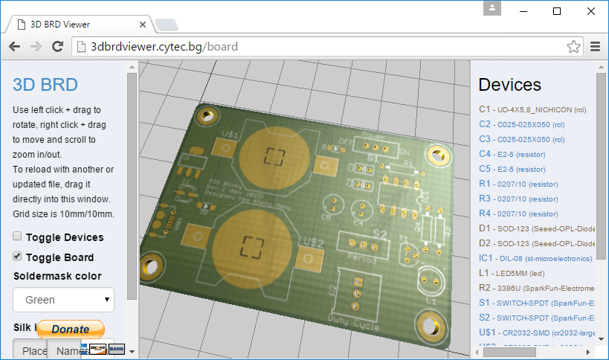
7. Do 3D rendering
Use this website http://3dbrdviewer.cytec.bg/
Check for any visible errors, especially silkscreen overlap
Check for components’ “closeness”.
Go back to Step 5 if not satisfied
1. Establish project requirements
2. Acquire parts and prototype
3. Design your PCB schematic
4. Run electrical rule check (ERC).
5. Design board: place parts & wiring
6. Setup/run design rule check (DRC)
7. Do 3D rendering
8. Use CAM file to generate Gerbers
9. Zip up relevant Gerber files
10. Set PCB fabrication settings
11. Write out bill of materials (BOM)
12. PCB Assembly

Slide 30
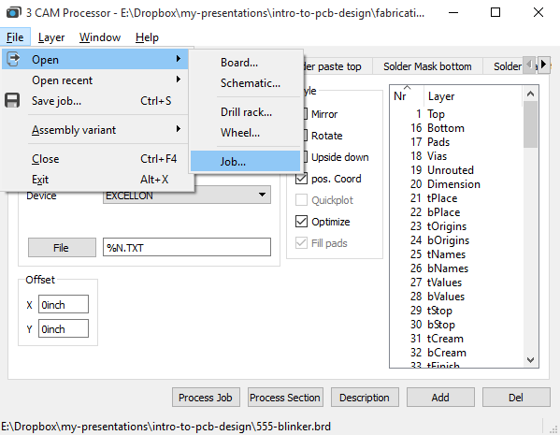
8. Use CAM file to generate Gerbers
Gerber files
2D vector format used by PCB fabricator to make PCBs for you
CAM file provided by fabricator to help you generate Gerber layer files
Download PCB fabricator’s CAM processor, in this case Elecrow
http://www.elecrow.com/10pcs-2-layer-pcb-p-1175.html
http://www.elecrow.com/download/Elecrow_Gerber_Generater_DrillAlign.zip
Use the correct CAM file according to number of layers like 2 layers
Open CAM Processor: File -> CAM Processor
Once in CAM Processor, load the CAM job as shown below
Once you are done, click “Process Job”
1. Establish project requirements
2. Acquire parts and prototype
3. Design your PCB schematic
4. Run electrical rule check (ERC).
5. Design board: place parts & wiring
6. Setup/run design rule check (DRC)
7. Do 3D rendering
8. Use CAM file to generate Gerbers
9. Zip up relevant Gerber files
10. Set PCB fabrication settings
11. Write out bill of materials (BOM)
12. PCB Assembly

Slide 31
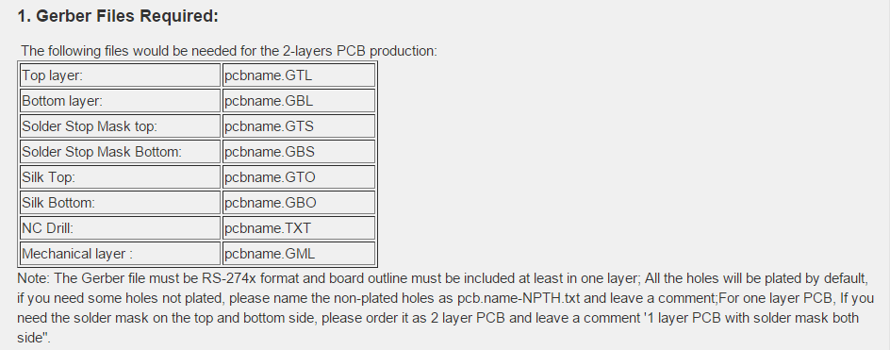
9. Zip up relevant Gerber files
See what files are required by the PCB fabricator
Elecrow’s requirements:
Go to saved folder and zip up the required files
Rightfully you should inspect your Gerber files for potential mistakes using software/websites like:
GR-Prevue: http://www.graphicode.com/GC-Prevue_Gerber_Viewer
http://circuitpeople.com/
http://mayhewlabs.com/webGerber/
But so far I don’t have any problems so I usually skip the Gerber file check step
1. Establish project requirements
2. Acquire parts and prototype
3. Design your PCB schematic
4. Run electrical rule check (ERC).
5. Design board: place parts & wiring
6. Setup/run design rule check (DRC)
7. Do 3D rendering
8. Use CAM file to generate Gerbers
9. Zip up relevant Gerber files
10. Set PCB fabrication settings
11. Write out bill of materials (BOM)
12. PCB Assembly

Slide 32
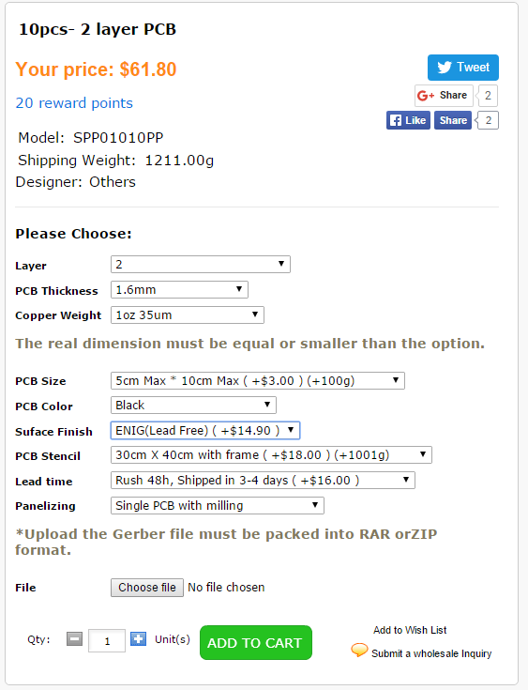
10a. Set PCB fabrication settings
Go to order page http://www.elecrow.com/10pcs-2-layer-pcb-p-1175.html
Basic options like PCB size, color and lead time self explanatory
1. Establish project requirements
2. Acquire parts and prototype
3. Design your PCB schematic
4. Run electrical rule check (ERC).
5. Design board: place parts & wiring
6. Setup/run design rule check (DRC)
7. Do 3D rendering
8. Use CAM file to generate Gerbers
9. Zip up relevant Gerber files
10. Set PCB fabrication settings
11. Write out bill of materials (BOM)
12. PCB Assembly

Slide 33
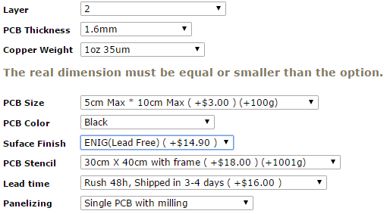
10b. Set PCB fabrication settings
Layer
1-layer with mask both side: 1 copper layer only but you want both sides soldermask/silkscreen
1-layer with mask one side: 1 copper layer only and you want one side soldermask/silkscreen
2-layer: normal two copper layer boards
Copper weight:
Copper layer thickness and amount, 1oz is usually enough
PCB Thickness:
Typical is 1.6mm
Elecrow can go as thin as 0.6mm for normal FR4 PCBs. Flex PCBs can go even thinner like 0.1mm
Surface finish
HASL vs ENIG next slide
PCB Stencil
Help you solder SMT components if you have solder paste and reflow oven/hotplate
Frame or no frame provided. I normally go with the frame as it just costs slightly more.
Panelizing
Squeeze many small PCBs into one piece to save space but you have to cut after receiving.
I normally pick “Single PCB with milling” as I have no need to panelize my PCB
1. Establish project requirements
2. Acquire parts and prototype
3. Design your PCB schematic
4. Run electrical rule check (ERC).
5. Design board: place parts & wiring
6. Setup/run design rule check (DRC)
7. Do 3D rendering
8. Use CAM file to generate Gerbers
9. Zip up relevant Gerber files
10. Set PCB fabrication settings
11. Write out bill of materials (BOM)
12. PCB Assembly

Slide 34
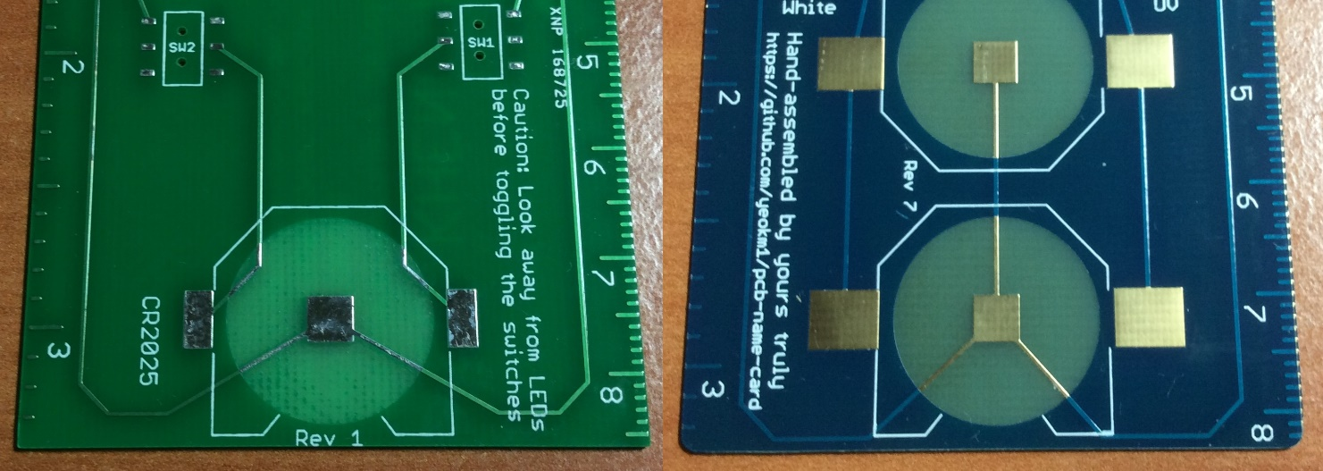
10c. Set PCB fabrication settings
Others:
Electrolytic Gold-plating, Immersion Silver, Immersion Tin, Organic Surface Protectant
1. Establish project requirements
2. Acquire parts and prototype
3. Design your PCB schematic
4. Run electrical rule check (ERC).
HASL vs ENIG
5. Design board: place parts & wiring
 | HASL (lead-free) | ENIG
Acronym for | Hot Air Solder Levelling | Electroless nickel immersion gold
How it is made? | Copper surfaces covered with solder by dipping PCB in solder then blowing away | Copper surfaces covered with nickel with gold coating via immersion
Coating evenness | Uneven, don’t use for fine-pitch SMD components | Very even coat, must use if you have fine SMD components.
Durability | Reasonable, but don’t expose too long to air | Better than HASL, can last for months
Solderability (should not factor in your decision) | Great | So-so
Cost | Low | High
6. Setup/run design rule check (DRC)
7. Do 3D rendering
8. Use CAM file to generate Gerbers
9. Zip up relevant Gerber files
10. Set PCB fabrication settings
11. Write out bill of materials (BOM)
12. PCB Assembly

Slide 35
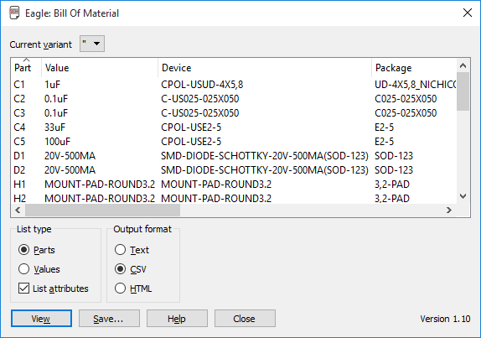
11. Write out bill of materials (BOM)
Export BOM and modify.
So others can replicate your PCB
Go to Schematic view, File -> Export -> BOM
Select Parts type and CSV format as shown
Use Libreoffice to open CSV file and save in its native ODS format
CSV not enough features, does not store column width
Some Excel versions have difficulty opening CSV file generated by Eagle
Open-source format
Modifying the generated BOM
Remove mounting holes
Collapse duplicate devices and combine their part designators
Remove: Description, OC_FARNELL, OC_NEWARK, PROD_ID, last VALUE column
Add: Quantity, Unit Cost , Total Unit cost (=Quantity * Unit Cost), Source webpage
Modify the generic Eagle BOM with the actual BOM data (also add PCB Fab cost)
Can have final Total Cost at bottom if you wish
1. Establish project requirements
2. Acquire parts and prototype
3. Design your PCB schematic
4. Run electrical rule check (ERC).
5. Design board: place parts & wiring
6. Setup/run design rule check (DRC)
7. Do 3D rendering
8. Use CAM file to generate Gerbers
9. Zip up relevant Gerber files
10. Set PCB fabrication settings
11. Write out bill of materials (BOM)
12. PCB Assembly

Slide 36
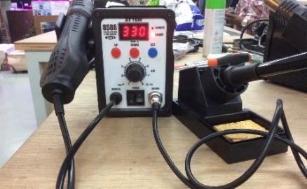
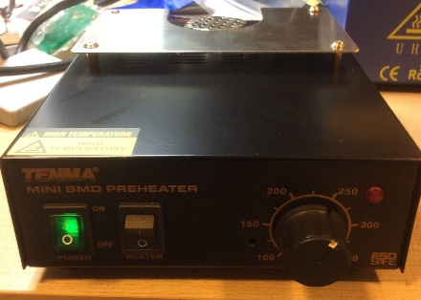
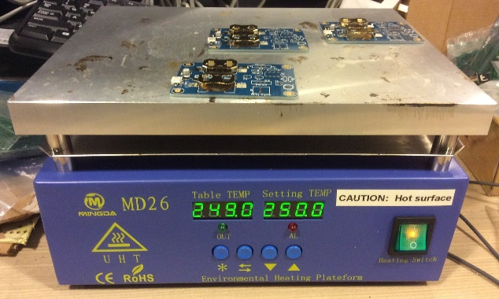
12a. PCB Assembly
Manual Soldering
Soldering station
Through-hole and SMT components
Specialised SMD Soldering techniques (with stencil and paste)
Hot air blower
Hot plate
Reflow oven
1. Establish project requirements
2. Acquire parts and prototype
3. Design your PCB schematic
4. Run electrical rule check (ERC).
5. Design board: place parts & wiring
6. Setup/run design rule check (DRC)
7. Do 3D rendering
8. Use CAM file to generate Gerbers
9. Zip up relevant Gerber files
10. Set PCB fabrication settings
11. Write out bill of materials (BOM)
12. PCB Assembly

Slide 37
12b. PCB Assembly
Reflow Soldering only for surface-mount components
Requires stencil and solder paste
FIRST stencil/reflow the SMD components THEN solder the through-hole components by hand.
A typical thermal profile, consult data sheet to determine optimum profile
Thermal profile based on:
Lead vs lead-free solder paste
Lead vs lead-free components
Lead vs lead-free use depends on RoHS compliance
Profile Steps
Preheat: Flux activation
Soak: Ensure all board and components are at the same temperature
Reflow: “Melts” solder paste and let it settle properly on the solder pads
Cooling: Brings temperature back down at controlled rate to prevent thermal stress
1. Establish project requirements
2. Acquire parts and prototype
3. Design your PCB schematic
4. Run electrical rule check (ERC).
5. Design board: place parts & wiring
6. Setup/run design rule check (DRC)
7. Do 3D rendering
8. Use CAM file to generate Gerbers
9. Zip up relevant Gerber files
10. Set PCB fabrication settings
11. Write out bill of materials (BOM)
12. PCB Assembly
Source: http://www.compuphase.com/electronics/reflowsolderprofiles.htm

Slide 38
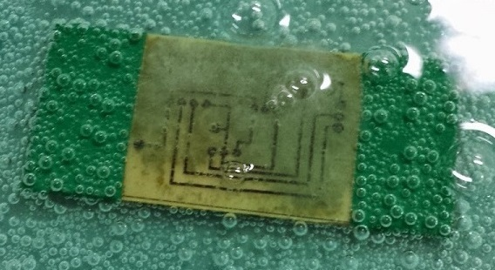
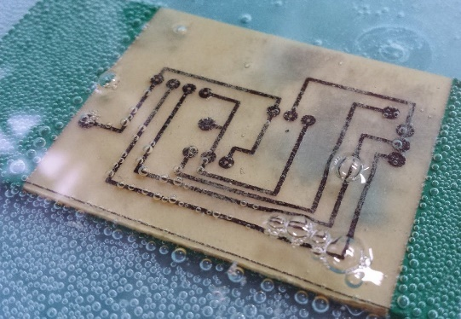
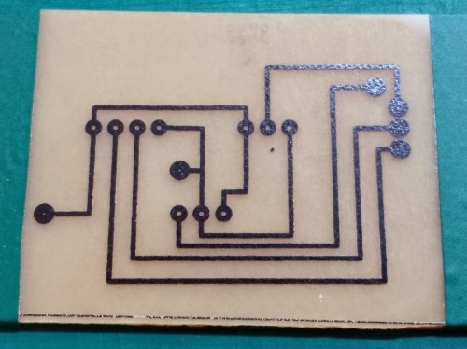
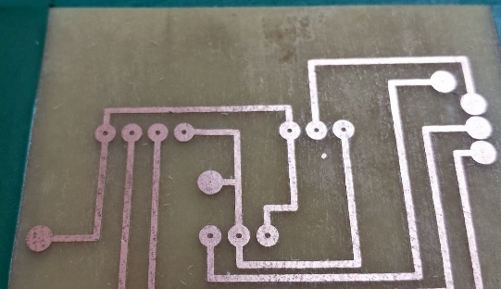
DIY PCB Fabrication (Toner transfer)
Materials
Liquid Mixture: Vineger, Table Salt, Hydrogen Peroxide (H₂0₂)
Transfer paper
FR-4 board
Steps
Print circuit diagram on transfer paper using laser printer
Iron/Heat press transfer paper into FR-4 board
https://www.youtube.com/watch?v=dvLRrXjktbE
Mix liquid mixture of vinegar, H₂0₂ and salt
Submerge FR-4 board in liquid mixture and agitate
Continue until all exposed copper has been “eaten away”. (Toner covers areas you want to leave behind)
Use a solvent/paint thinner to wipe off the toner
Drill holes to create vias
Source, Leon Lim: http://gylim78.blogspot.sg/2014/07/the-diy-pcb-making-guide.html http://gylim78.blogspot.sg/2015/05/pcb-board-gallery.html

Slide 39
Time to design your own board!

Slide 40
Final Words
This is just the beginning
Practice makes perfect, the more PCBs you design/fabricate, the better you will get
Unlikely to get right on the first fabrication attempt
2-3 times or more per design

